Slide 1
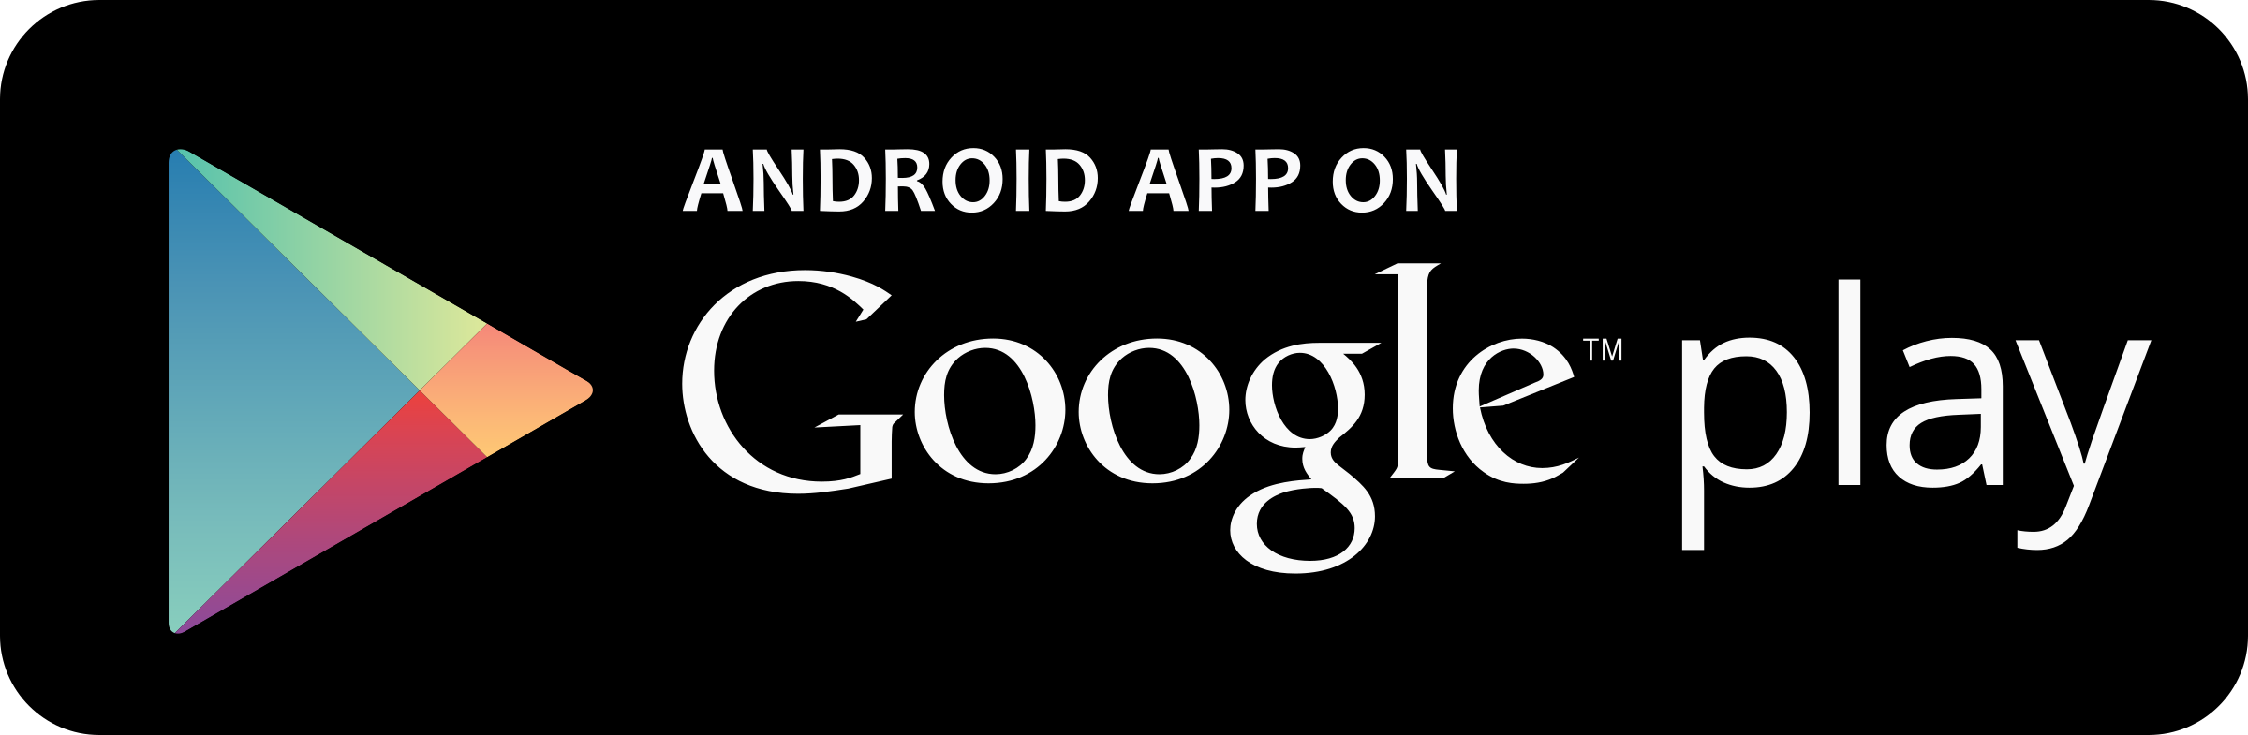
MIT Hub
Better Learning Together -
Android Application

Slide 2

Aim & Objectives
The aim of this project is to facilitate MIT students with better communication/interaction within the MIT environment. The objectives are;
Research on different features that could be added onto the application.
Research on the most useful categories within the app that would be beneficial to the app users
Develop the app based on the research

Slide 3

SCOPE
To create an android application that will act as a mobile hub for MIT students
MOV
To improve MIT Students’ learning possibilities via using MIT Hub mobile app with the expected increase of students’ A Grading (- & + combined) by 10% within one year.

Slide 4

Added Value & Areas of Impact
Added Values 1. Ease of Use - On the move, Notifications, Quick Response 2. Better Access - Not limited to learning only, Future Sections 3. Better Learning - Knowledge Sharing 4. Improve Communication - Language
Areas of Impact 1. Assessment and Exams/Knowledge Uplifting 2. Resource Sharing (Accommodation/Ride-sharing)

Slide 5
Platforms & Expected Functionalities
Platforms
Android Studio
Microsoft SQL Server Management Studio
Google Drive
GitHub
Functionalities
Post Discussion Topic
Post a Reply to the Discussion
Browse Discussions Under a Specific Category

Slide 6
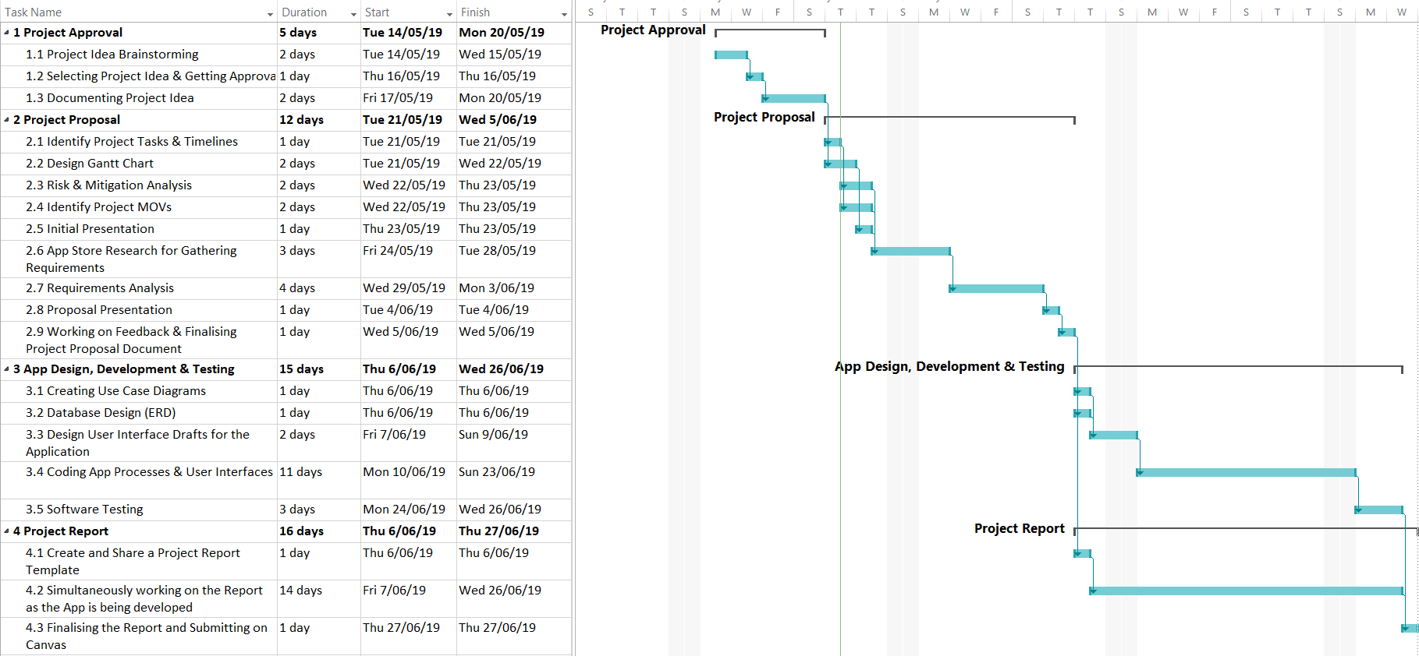
Gantt Chart

Slide 7
Work Breakdown Structure
Design Gantt Chart
Risks & Mitigation Analysis
SANKET
Identify Project MOVs
Create Use Case Diagrams
Drafting App UIs
Documentation
Coding App Processes & UI
ANGELO
Finalising & Submitting Documents

Slide 8
Risk Assessment & Mitigation
Scheduling Risk
Limited Scope
Limited Experience
Lots of Research
Task Planning & Scheduling
Seeking Advice from Lecturers & Friends
Communication Risks
Proper Documentation
Team Meetings
Persistently Bugging Team Members
Requirements Inflation
Stick to the scope
Get the Basic App Working First

Slide 9
Questions?

